Slide 1

Integrated NLP Pipeline : From Regular Expressions to Morphological Processing
DSA0305-Natural Language processing
Presented By
M. Manoj Kumar
192425114
Guided By
Dr. K. Anbazhagan

Slide 2
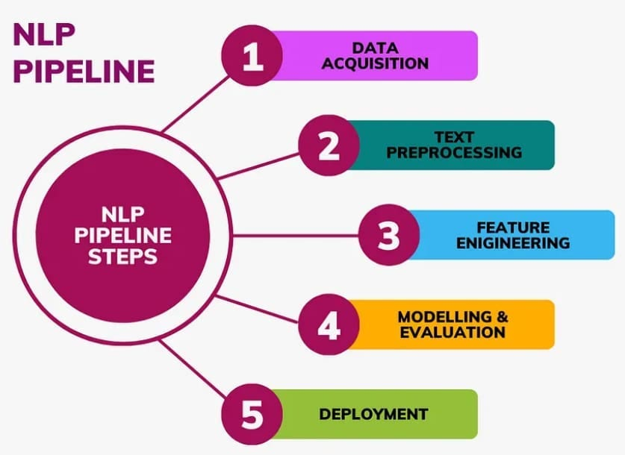
Introduction
Natural Language Processing (NLP) helps computers understand and process human language.
An integrated NLP pipeline combines different techniques to prepare text for analysis.
Regular Expressions (Regex) are used to clean text and identify patterns.
Morphological processing analyzes the structure of words, including their root forms.

Slide 3
Objectives
To clean and preprocess text using Regular Expressions.
To identify and analyze the root form of words through morphological processing.
To improve the quality and accuracy of text analysis.
To prepare text for advanced NLP applications such as chatbots and machine translation.

Slide 4
Problem Statement
Raw text often contains unwanted symbols, punctuation, and inconsistent formatting.
Words appear in different forms, making language processing difficult.
Basic text processing techniques cannot accurately understand word meanings.
An integrated NLP pipeline is needed to clean text and analyze word structures effectively.

Slide 5
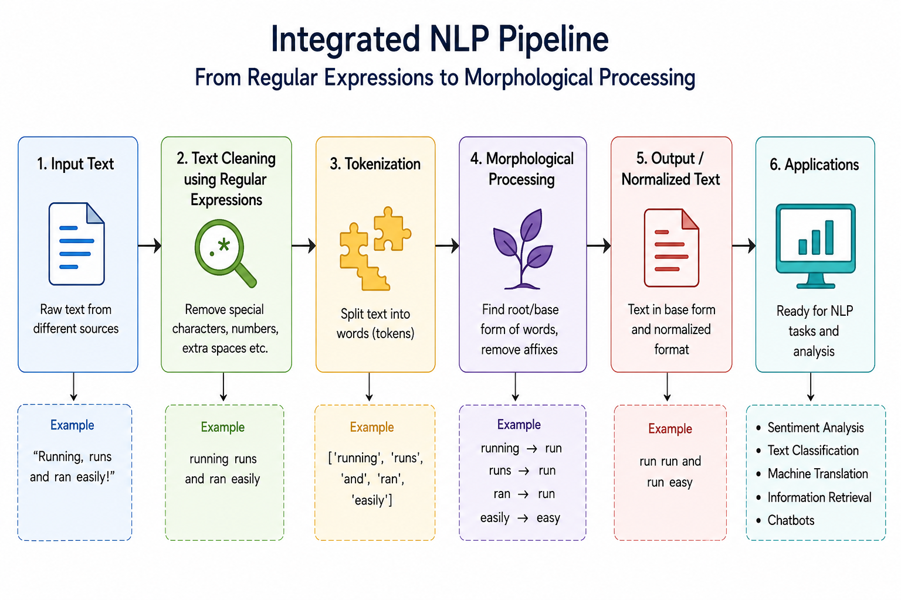
System Architecture

Slide 6
Conclusion
The integrated NLP pipeline provides an efficient way to process text data.
Regular Expressions help in cleaning and extracting useful information.
Morphological processing improves understanding of word meanings and root forms.
Together, these techniques increase the accuracy and performance of NLP systems.

Slide 7
Thank you

